Slide 1
Name
Course
Instructor
World Regional Geography

Slide 2
Qestion 3.
Globalization has definitely transformed life in India in almost all aspects of life.
The middle class, though, has been a major benefactor of globalization.
The establishment of technological companies in the country has increased employment opportunities for the young population and college graduates.
Globalization has also encouraged foreign companies to invest in the Indian economy like the MobiLuft airlines to compete with the state owned which improves service delivery to the travelers.
It also avails more affordable amenities to the population which improves the quality of life for the middle class.
Media privatization also has created a varied choice of products to consumers an aspect that encourages competition an business growth.

Slide 3
Question 4.
Despite the numerous benefits that come with globalization, it also has its adverse effects which mainly affect the poor and low class citizens in developing countries.
This, though, does not mean that it is entirely bad and should be abandoned.
The costs that are incurred due to globalization mainly result from mismanagement of the resources and greed.
The governments of various developing nations should implement laws that protect their populations against corporate exploitation.
Globalization steers development and when managed responsibly can be of benefit even to the poor who are perceived as victims globalization.
The costs can be endured as stakeholders move to ensure that globalization is inclusive to all classes of the society.
With time, the costs can be reduced or cut which calls for better governance of initiatives and globalization can pay for its costs.

Slide 4
Question 5
Despite the uniting and homogenizing effect that comes with globalization, a common phenomenon can be noticed where people are trying hard to belong to a group to create their identity or risk being assimilated in the global wave.
This fragmentation of a population to create a identity is called polarization.
In the entertainment scene for example, is the Black Entertainment (BET) which is a celebration of black culture and heritage more that music itself.
Thus year's ramadhan celebrations also received more publicity than never which can explain the need to preserve the religious identity in an homogeneous country.
The trade wars that are a result of globalization also lead to further polarization each one promoting their affiliate company.

Slide 5
Question 6
Despite the numerous adversities caused by globalization, it is generally more beneficial than degrading.
As an individual, I support globalization mainly because it ensures uniformity in development in different countries and regions in the world.
It ensures that some countries are centuries ahead of others in terms of infrastructure, education and poverty levels.
The study video shows the impacts of globalization to the Caribbean banana farmers as a result of trade wars in the Americas affecting the export business.
This happening forces the farmers to looks for other income supplements or face unemployment hence poverty.
In the video some banana farmers opted to switch to marijuana farming. Those who could not, especially women, endured low market and ventured in other industries like tourism.

Slide 6
Question 7(a)
In the study video talking about how classism and energy use sync with development and globalization, the term wash line, I think, was used to explain the threshold of population that can at least afford a washing machine for convenience.
Thus is a representation that can conveniently own a washing machine and their expenditure is above 40$ per day.
Question 7 (b)
The video highlights what happens when development in a population and the reflections it has in the energy use and affordability.
Every person strives to achieve convenience and increase their productivity both of which are fueled and enhanced by globalization.
Economic and population growth affect energy use around the globe and it(globalization) has to continue regardless of the effects it has on the environment since everyone wants convenience for productivity because of its benefits.
Thus means that industries have to use green energy to sustain globalization and development.

Slide 7
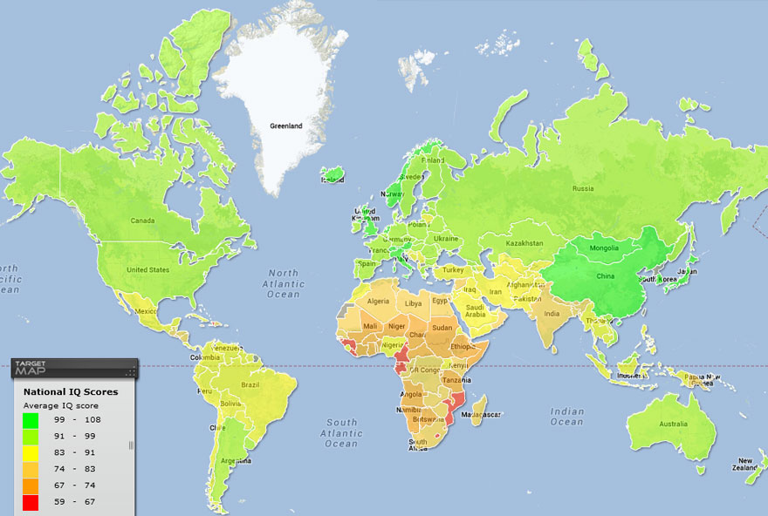
Question 9. The map I chose for this question illustrates the national Intelligence quotient (IQ) of different countries in the world.
It checks the average IQ scores of entire countries. The map was adopted from targetmap.com.

Slide 8
Question 11(a)
The video is an illustration of how the world health and wealth expressed in terms of life expectancy and income has changed through time for the past 200 years.
The differences in the countries' health and wealth was an influence of historical events like the world wars which weaken Japanese and German economies.
The cold war and the effects it had on both American and Russian populations.
Industrialization was also a major boost to economies like China while economic and health policies in Denmark and Switzerland are responsible for their high life expectancies.
The video generally describes how the world is working towards uniform and homogenized development.
The fact that over 2 billion people still don't use mobile phones in the 21st century shows the disparity in the world.
Millions also starve and go without food in various parts of the world; an indication that we are yet to achieve balance in resource distribution.
Uniformity is impossible to achieve, at least not in the next century, according to my opinion. It will take longer than expected mainly due to corrupt government which stall poverty eradication .
Resource allocations is also a major cause for varied regional development

Slide 9
Question 12.
To avoid being politically incorrect, one can just say that there are around 200 countries.
This comes as a surprise since it seems like a simple straight forward question which requires a direct precise answers.
The matter is complicated by the fact that for a country to be considered a country, other countries must consider it to be.
This makes some countries to be considered so by some and not by others.
For example, Kosovo is considered by some countries like USA and UK while China and Russia do not which makes it to miss from the UN.
The number of countries remains an estimate because of the policies involved in determining whether it is a country or not.

